Slide 1
Output devices
Abdul wali
Student of BSSE

Slide 2
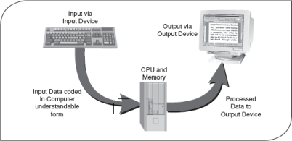
Output devices
An output device is any hardware component that conveys information or data to the user in different form such as (hardform, vissual,adiuo,digital).
These devices take processed data from a computer and convert it into a format that humans can understand .

Slide 3
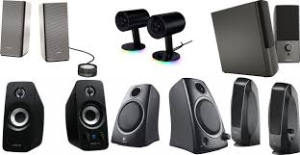
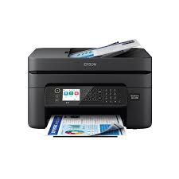
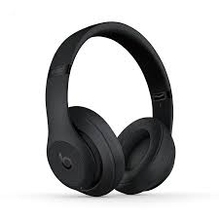
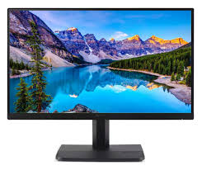
Types of output devices
There are many out put devices some of them discuss below:
Speaker
Printer
Projector
Monitor
Headphones

Slide 4
Speaker
Output devices that convert digital audio signals into audible sound.
Example: Listening to music or audio from a video on computer speakers or external sound systems.

Slide 5
Printer
A device that converts digital text or images into physical form on paper or other materials.
Example: Printing a report from Microsoft Word or a photograph from your computer.

Slide 6
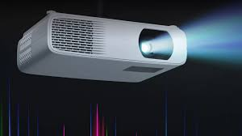
Projector:
A device that projects visual output from a computer or other digital device onto a large screen or surface, typically for presentations or movies.
Example: Displaying a PowerPoint presentation in a classroom or showing a movie at home .

Slide 7
Monitor
A display device that visually presents data or information, such as text, images, or videos, generated by the computer.
Example: Watching a YouTube video or editing a document on a computer screen.

Slide 8
Headphones:
Similar to speakers, but designed for personal audio output, headphones deliver sound directly to the user's ears.
Example: Using headphones to listen to music on a laptop or smartphone.

Slide 9
Thank you !
The End

